Slide 1

Air Pollution Analysis on Air Quality Index (AQI)
The Air Quality Index (AQI) is a system used to show how clean or polluted the air is in a certain place. It helps people understand if the air is safe to breathe and what health problems it might cause.
ss
by subash sahani

Slide 2

Objective of the Project
1
Understanding Air Pollution
2
Analyzing Trends
The project might also look at how air pollution changes over time, find out where pollution is coming from, and explore ways to improve air quality and reduce pollution.
The main goal is to study real-time air pollution data and understand how it affects people's health and the environment.

Slide 3
Key Components of the Project
1
Data Collection
Gather air pollution information from sources like government stations, sensors, or satellites.
2
AQI Calculation
Calculate the Air Quality Index (AQI) using a formula that looks at the levels of different pollutants.
3
Visualization
Create maps and graphs to show where the pollution is the worst and how it changes over time.
4
Health Impacts
Study how different AQI levels affect people's health, especially sensitive groups like children and the elderly.
5
Pollution Source Identification
Track where pollution is coming from, such as vehicles, industries, agriculture, construction, and natural sources.
6
Policy and Mitigation Strategies
Suggest ideas to lower pollution, such as creating stricter rules to limit emissions from factories and cars.

Slide 4
Tools and Technologies Used in the Project
Programming Languages
Data Sources
Databases
Use CSV data from Kaggle, and explore real-time data from APIs like OpenWeatherMap.
Consider using OpenAQ for open-air quality data and weather APIs for integrating real-time weather data.
Python is a great choice for data analysis, visualization, and machine learning.

Slide 5

Benefits of the Project
Informed Public
Policy Impact
The project helps people understand the current air quality, so they know when it’s safe or dangerous to go outside.
The data collected can help government officials and policymakers make better decisions about how to control air pollution.
Environmental Protection
Health Monitoring
The project helps keep track of how bad air quality affects people's health. It provides valuable data that can be used in public health research.
By tracking where pollution comes from, the project helps us find out the sources, such as factories, vehicles, or wildfires.

Slide 6
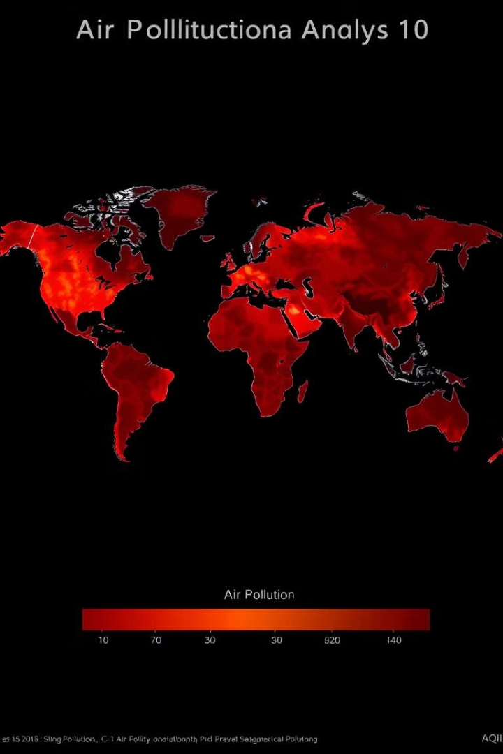



Challenges in the Project
Data Accuracy
The quality of AQI data depends on how accurate the sensors and data collection methods are.
Data Coverage
Some places may not have enough air quality monitors, so there might be missing data in certain areas.
External Factors
Things like weather conditions or the changing seasons can affect how polluted the air is.

Slide 7

Conclusion
An air pollution analysis project focusing on the Air Quality Index (AQI) is an important effort to understand how air pollution affects both our health and the environment.
By gathering and examining air quality data, the project helps us see how pollution levels vary over time, how they impact people's health, and how different policies or actions can help improve air quality.
This analysis can guide better decisions to protect public health and reduce the harmful effects of pollution on the ecosystem.

Slide 8





Next Steps
Data Collection
Model Development
Continue to gather and analyze air quality data from various sources.
Develop predictive models to forecast air quality based on historical data and environmental factors.
Public Engagement
Policy Recommendations
Educate the public about air quality and encourage participation in pollution reduction efforts.
Provide evidence-based recommendations to policymakers for effective air pollution control measures.

